Slide 1
Linear Algebra
Lecture 15

Slide 2
Matrix
Algebra

Slide 3
Matrix
Factorizations

Slide 4
Definition
A factorization of a matrix A is an equation that expresses A as a product of two or more matrices

Slide 5
Definition
Suppose A can be row reduced to echelon form, without row interchanges, then A can be written as A = LU, where L is a lower triangular matrix with 1’s on the diagonal and U is an echelon form of A. This is called an LU factorization of A.

Slide 6
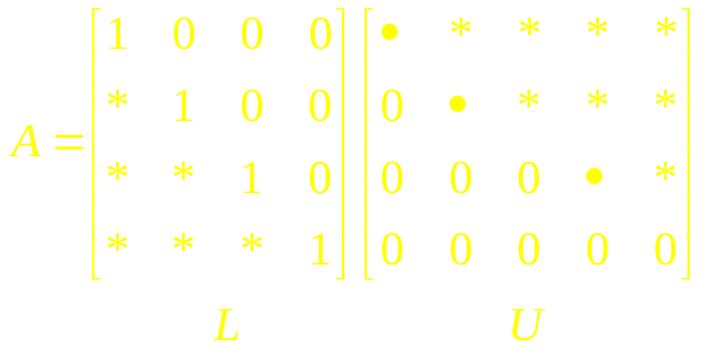
Continued…
The matrix L is invertible and is called a unit lower triangular matrix.

Slide 7
Note
If A is a square matrix of order mxm, then the order of both L and U will also be m x m.

Slide 8
Remarks
In general, not every square matrix A has an LU-decomposition, nor is an LU-decomposition unique, if it exists.

Slide 9
Theorem
If a square matrix A can be reduced to row echelon form by Gaussian elimination with no row interchanges, then A has an LU-decomposition.

Slide 10
Algorithm
Reduce A to an echelon form U by a sequence of row replacement operations, if possible.
Place entries in L such that the same sequence of row operations reduces L to I.

Slide 11
Procedure
1. Reduce A to row echelon form U without using row interchanges, keeping track of the multipliers used to introduce the leading 1’s and the multipliers used to introduce zeros below the leading 1’s.

Slide 12
Continued
2. In each position along the main diagonal of L, place the reciprocal of the multiplier that introduced the leading 1 in that position in U.

Slide 13
Continued
3.In each position below the main diagonal of L, place the negative of the multiplier used to introduce the zero in that position in U.
4.Form the decomposition A = LU.

Slide 14
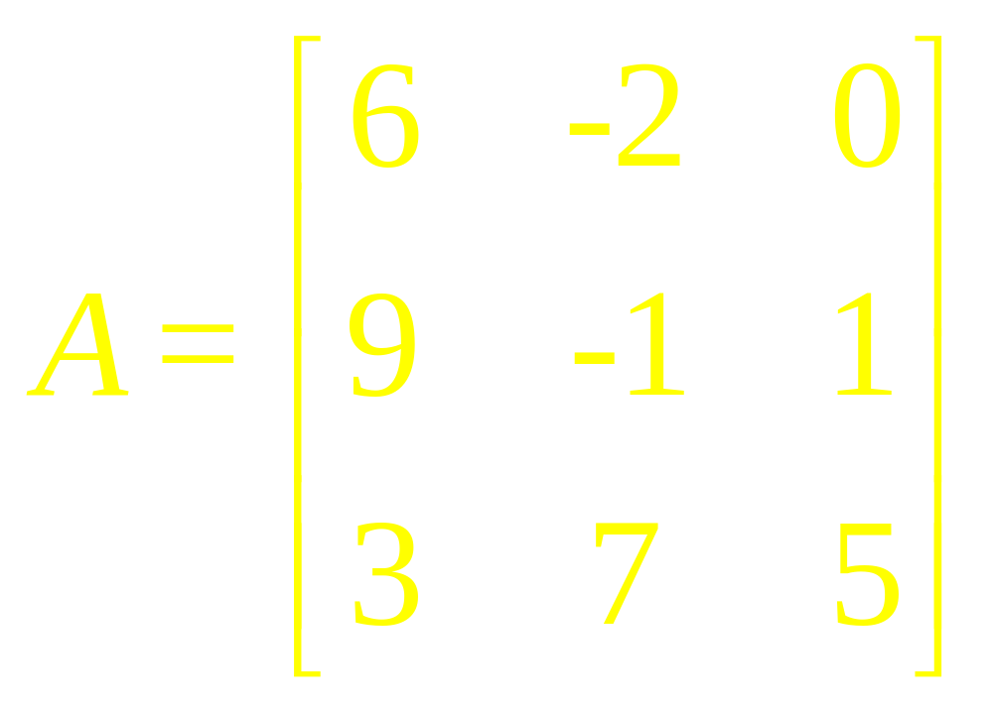
Example 1
Find an LU-decomposition of

Slide 15
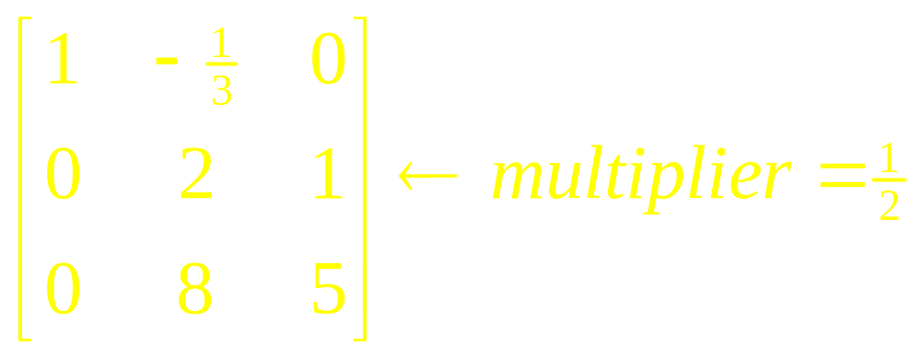
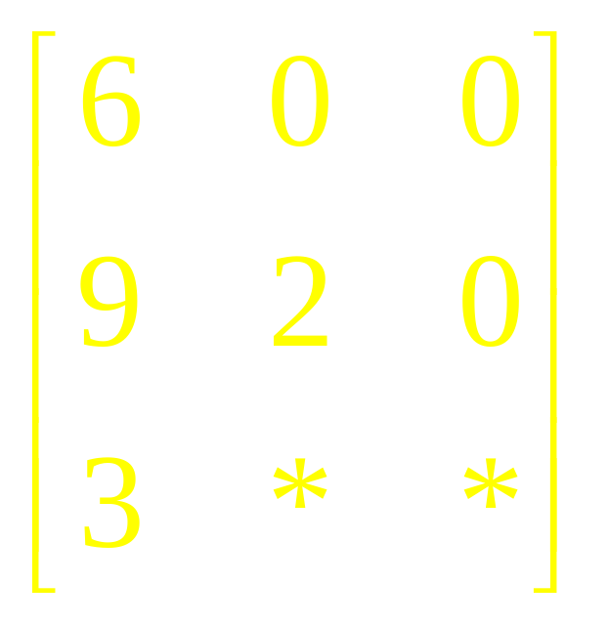
Ex 1(Sol)

Slide 16
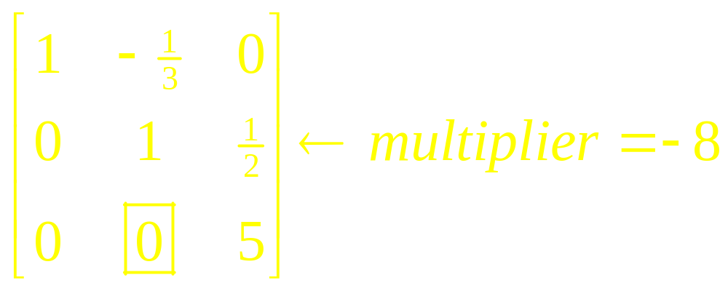
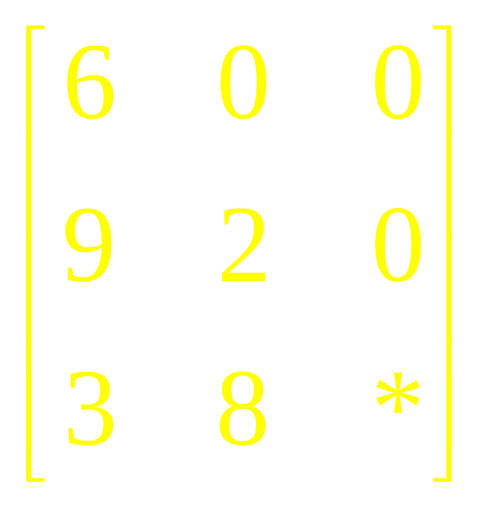
Ex 1(Sol)

Slide 17
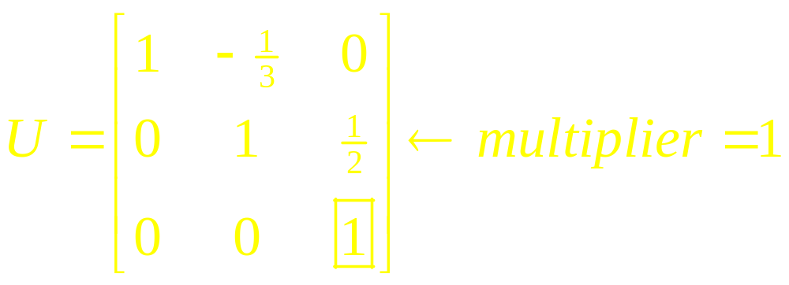
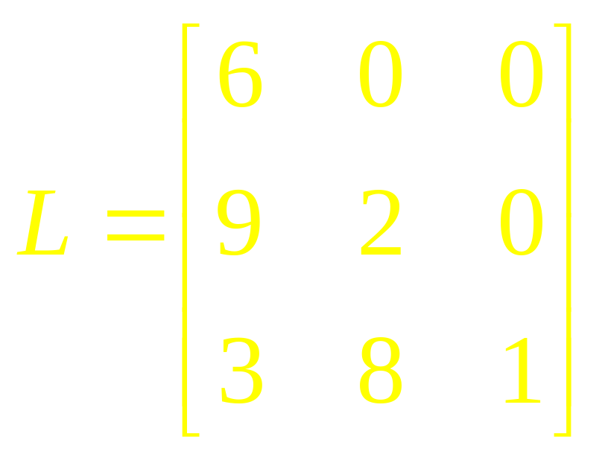
Ex 1(Sol)

Slide 18
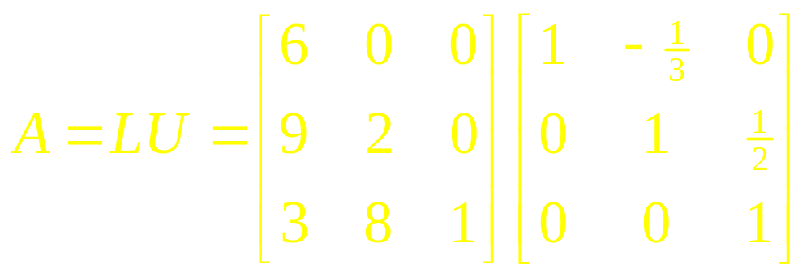
Ex 1(Sol)

Slide 19
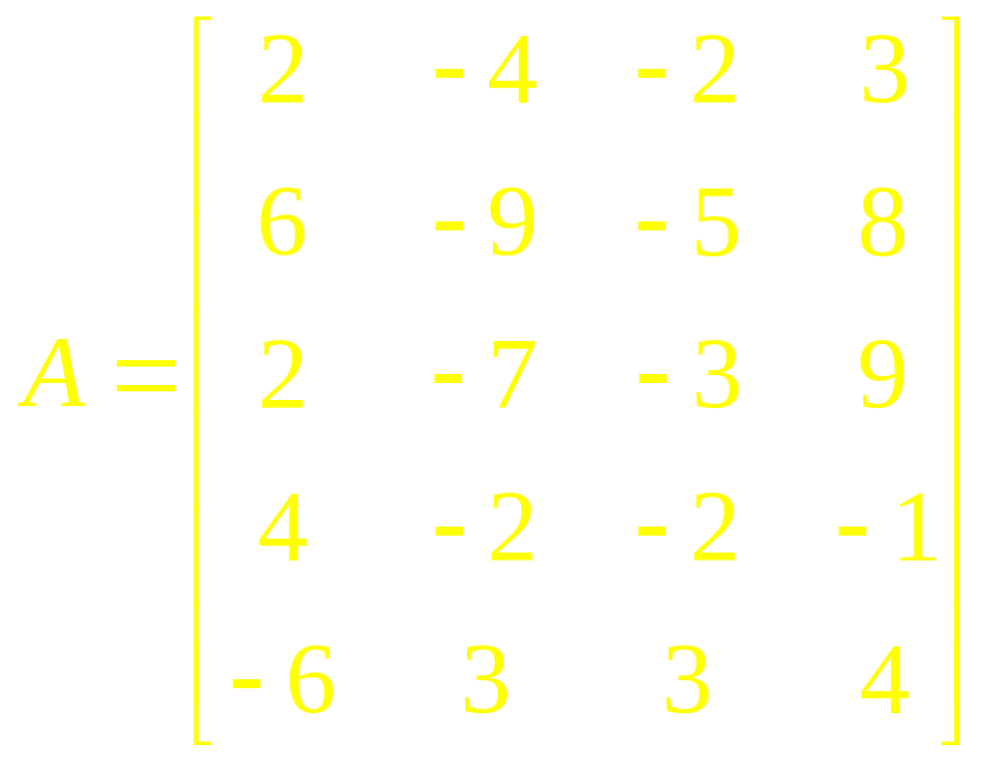
Example 2
Find an LU-factorization of

Slide 20
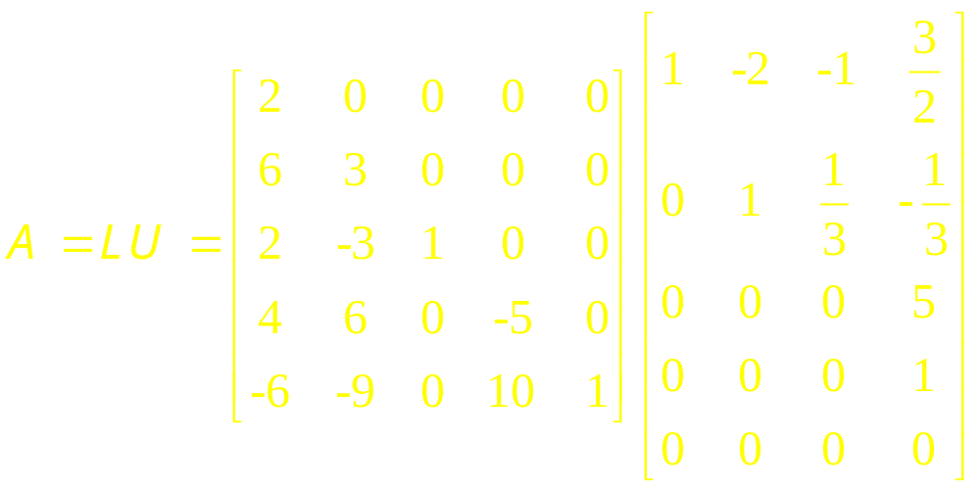
Ex 2 (Sol)

Slide 21
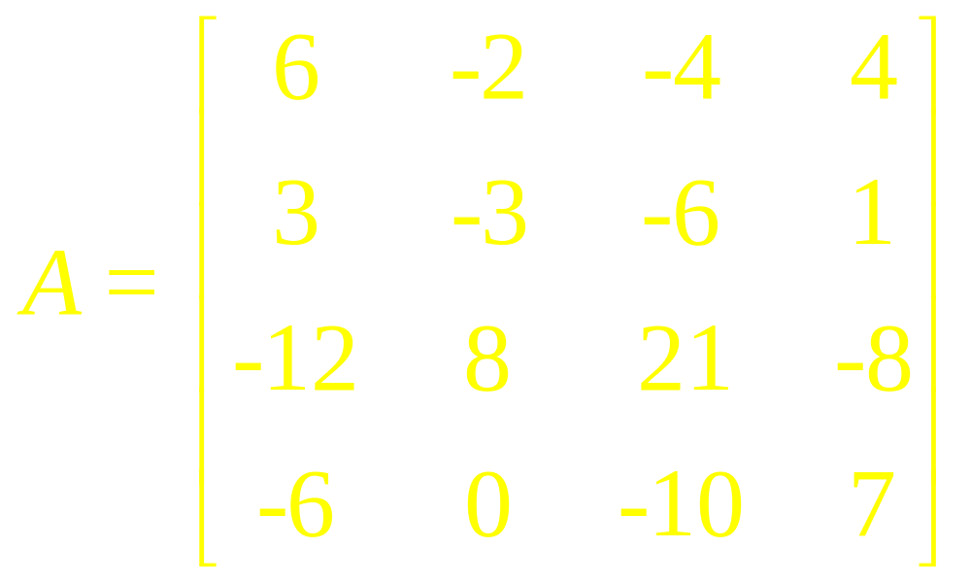
Example 3
Find an LU-factorization of

Slide 22
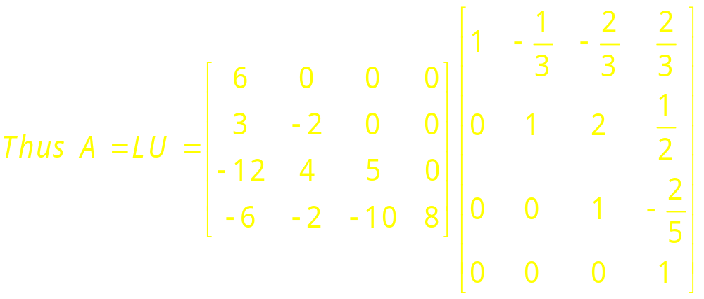
Ex 3 (Sol)

Slide 23
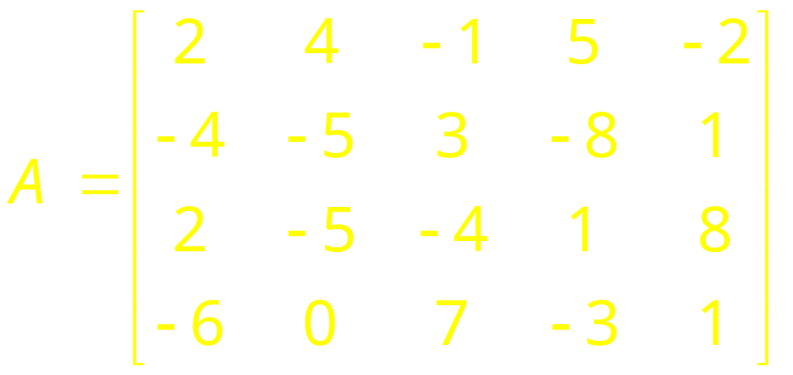
Example 4
Find an LU-decomposition of

Slide 24
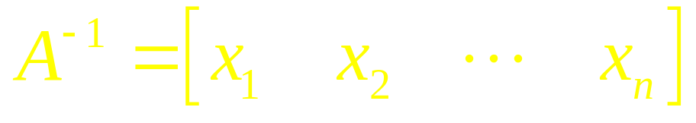
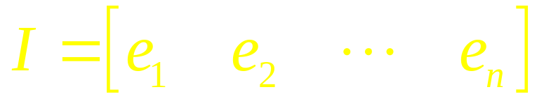
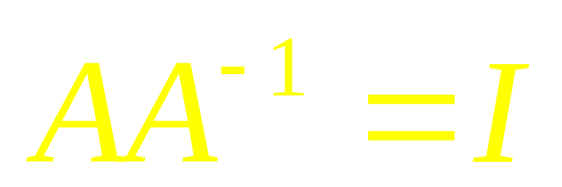
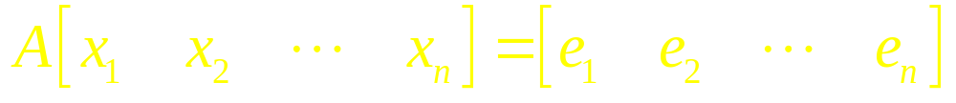
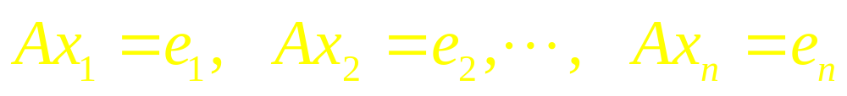
Matrix Inversion

Slide 25
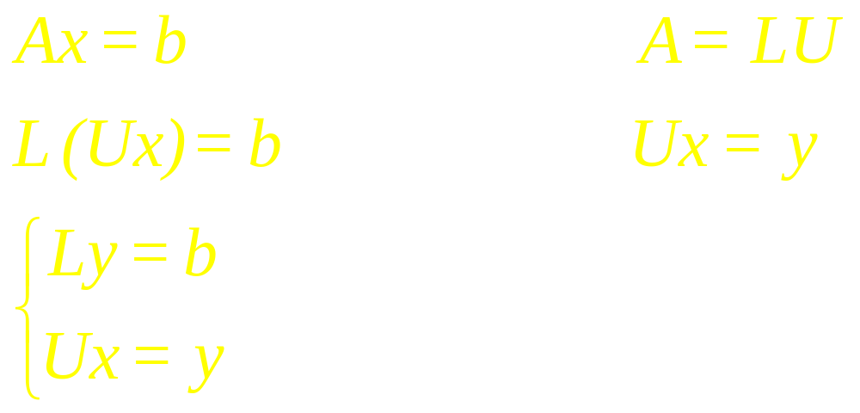








Solving Linear Systems

Slide 26
Procedure
1. Rewrite the system A x = b as LUx = b (1)
2. Define a new unknown y by letting Ux=y (2)
And rewrite (1) as L y = b

Slide 27
Continued
3. Solve the system L y = b for the unknown y.
4. Substitute the now-known vector y into (2) and solve for x.

Slide 28
Examples

Slide 29
Linear Algebra
Lecture 15

